Slide 1

Research Progress Record
Enmao Diao
Aug 28, 2018

Slide 2
Abstract
Compression and Classification
Data
Compression
Classification
Multi-Objective Optimization
Preliminary Result
Next Step
Distributed Compression
Codec Conversion

Slide 3
Compression and Classification
Data
MNIST dataset
60000 handwritten 0-9 digits images for training, 10000 for test
Original shape 28x28, resized to 32x32
CIFAR10 dataset
50000 natural images of 10 classes like airplane, automobile, cat, dog, etc for training, 10000 for test
Original shape 32x32
CIFAR100, ImageNet, COCO and more

Slide 4
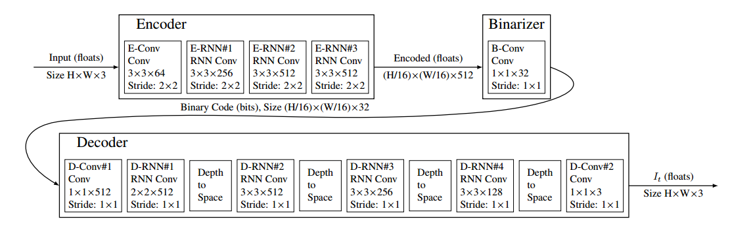
Compression and Classification
Compression
Model
16 iterations each iteration contains 32*2*2= 128 bits, bpp=0.125 for one iteration

Slide 5
Compression and Classification
Classification
Model
Conv2d(num_iter*32, 128, kernel_size=1, stride=1, padding=0)
FC(512,128)
FC(128,10)

Slide 6
Compression and Classification
Multi-Objective Optimization
Objective:
MSELoss + tuning_param * CrossEntropyLoss
tuning_param = 1e-3

Slide 7
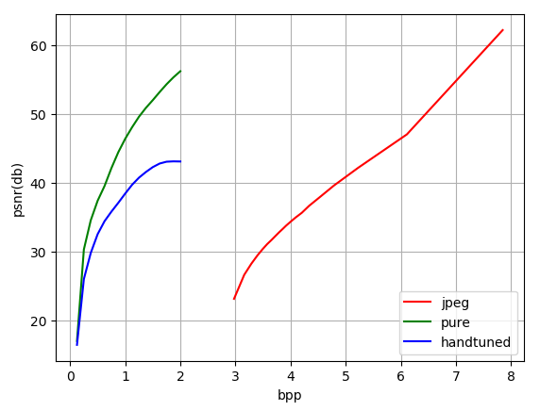






Compression and Classification
Preliminary Result
Handtuned achieves 98.64% accuracy
Original
1st iteration
2nd iteration
5th iteration
10th iteration
16th iteration

Slide 8
Compression and Classification
Next Step
Classification part is not rate variable
Tuning parameter for multi-objective optimization or two stage (isolated) optimization
More complex iid image data, like CIFAR10, ImageNet
Video data, and add LSTM for patch data? for frame data?
Web crawler for retrieving large volume of data to search for architecture and compressing images

Slide 9
Distributed Compression
Next Step
Split image dataset into several subset of data
Each slave node has a sperate encoder
The main host receive the codes from slave nodes and concatenate them together to decode them from a single decoder
The system should yield better rate-distortion curve compared to decode each slave node separately
Possible to add classification and other objectives

Slide 10
Codec Conversion
Next Step
Convert between classical codecs like jpeg, png and neural network based codecs
Convert between neural network based codecs
Convert between classical codecs
Can we convert between lossy compressed codes and lossless compressed codes with neural network

